Slide 1
Shock Waves and Expansion Waves

Slide 2
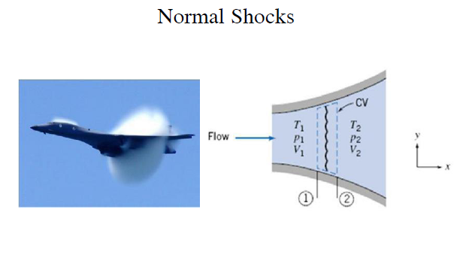

Slide 3
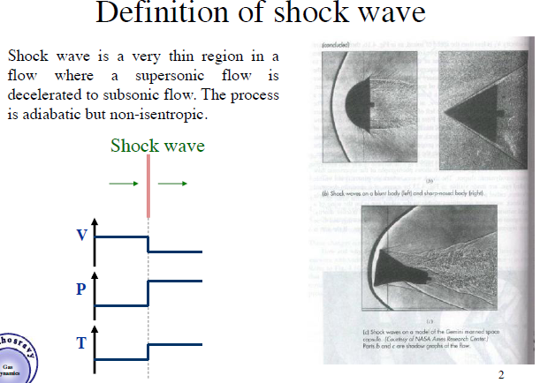

Slide 4
1] Shock Wave
* The extremely thin region in which the transition from the supersonic velocity, relatively low pressure state to the state that involves a relatively low velocity and high pressure is termed a shock wave.
* finite pressure disturbance, compressive elastic wave of finite strength
* nonlinear addition of the individual Mach waves emitted from each point on the body of finite thickness (or finite attack angle, not point projectile).
* The shock wave is an abrupt disturbance that causes discontinuous and irreversible changes in such fluid properties as

Slide 5
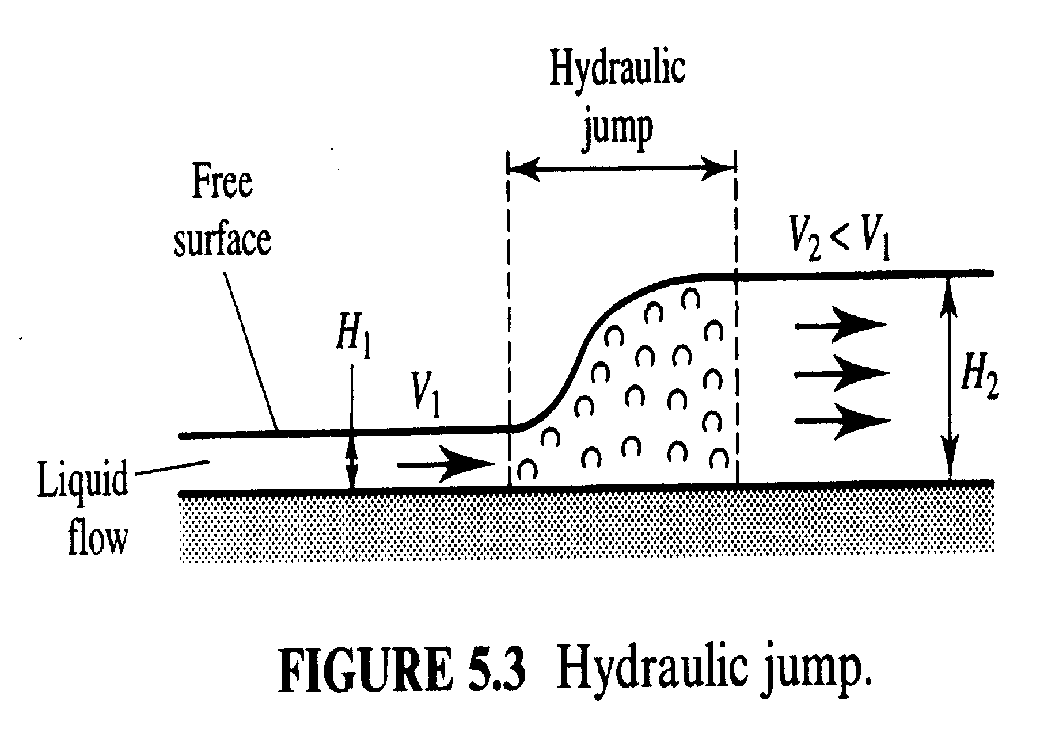

Slide 6
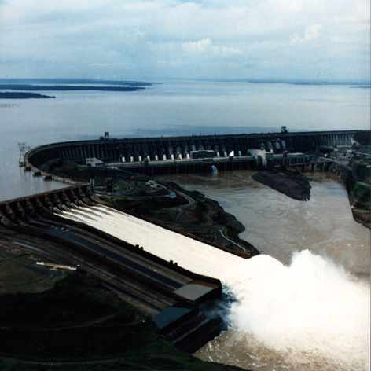
A spectacular hydraulic jump at the end of a spillway.

Slide 7
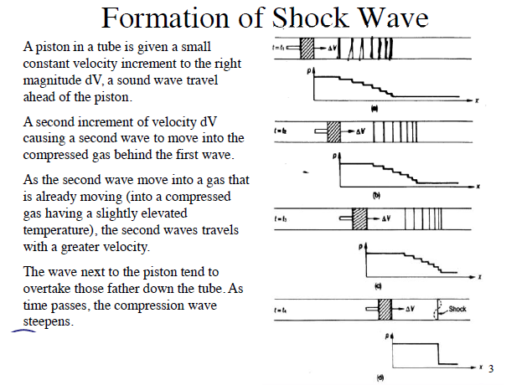

Slide 8
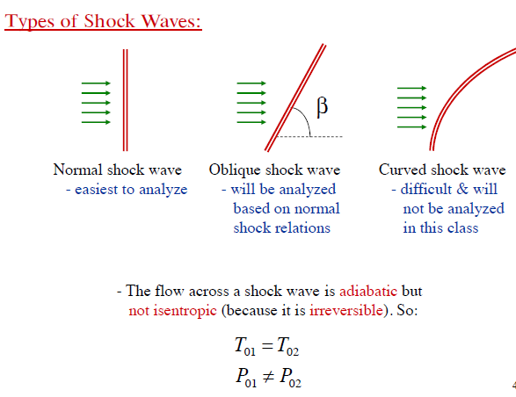

Slide 9
Shock Waves and Expansion Waves
Review
  Sound waves are created by small pressure disturbances and travel at the speed of sound
  For some back pressures, abrupt changes in fluid properties occur in C-D nozzles, creating a shock wave
Here, we will study the conditions under which shock waves develop and how they affect the flow.

Slide 10
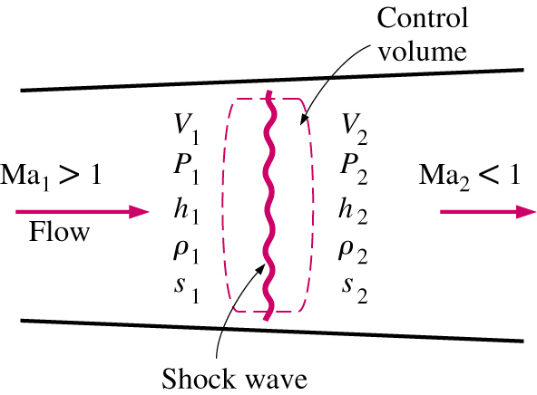
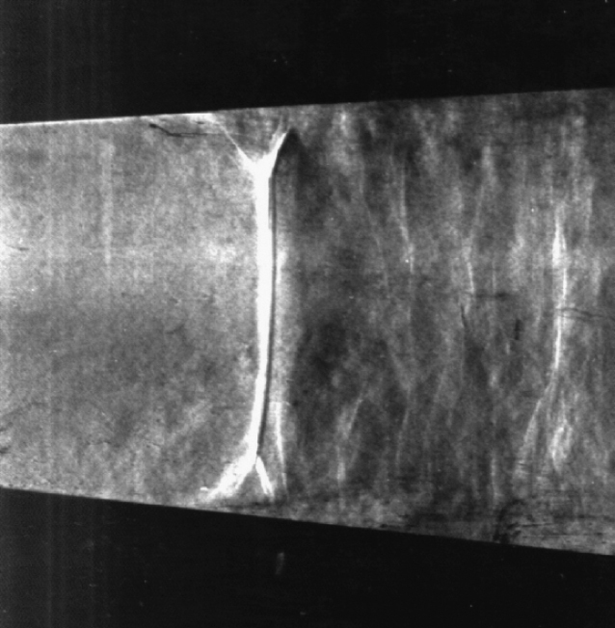
Shock Waves and Expansion Waves
Normal Shocks
Shocks which occur in a plane normal to the direction of flow are called normal shock waves
Flow process through the shock wave is highly irreversible and cannot be approximated as being isentropic
Develop relationships for flow properties before and after the shock using conservation of mass, momentum, and energy

Slide 11
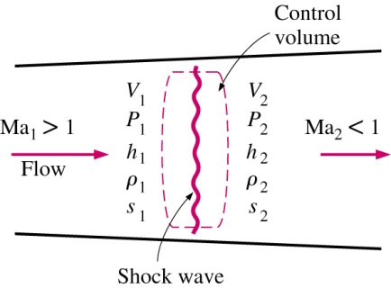
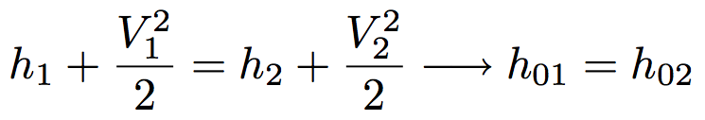


Shock Waves and Expansion Waves
Normal Shocks
Conservation of mass
Conservation of energy
Conservation of momentum
Increase in entropy

Slide 13
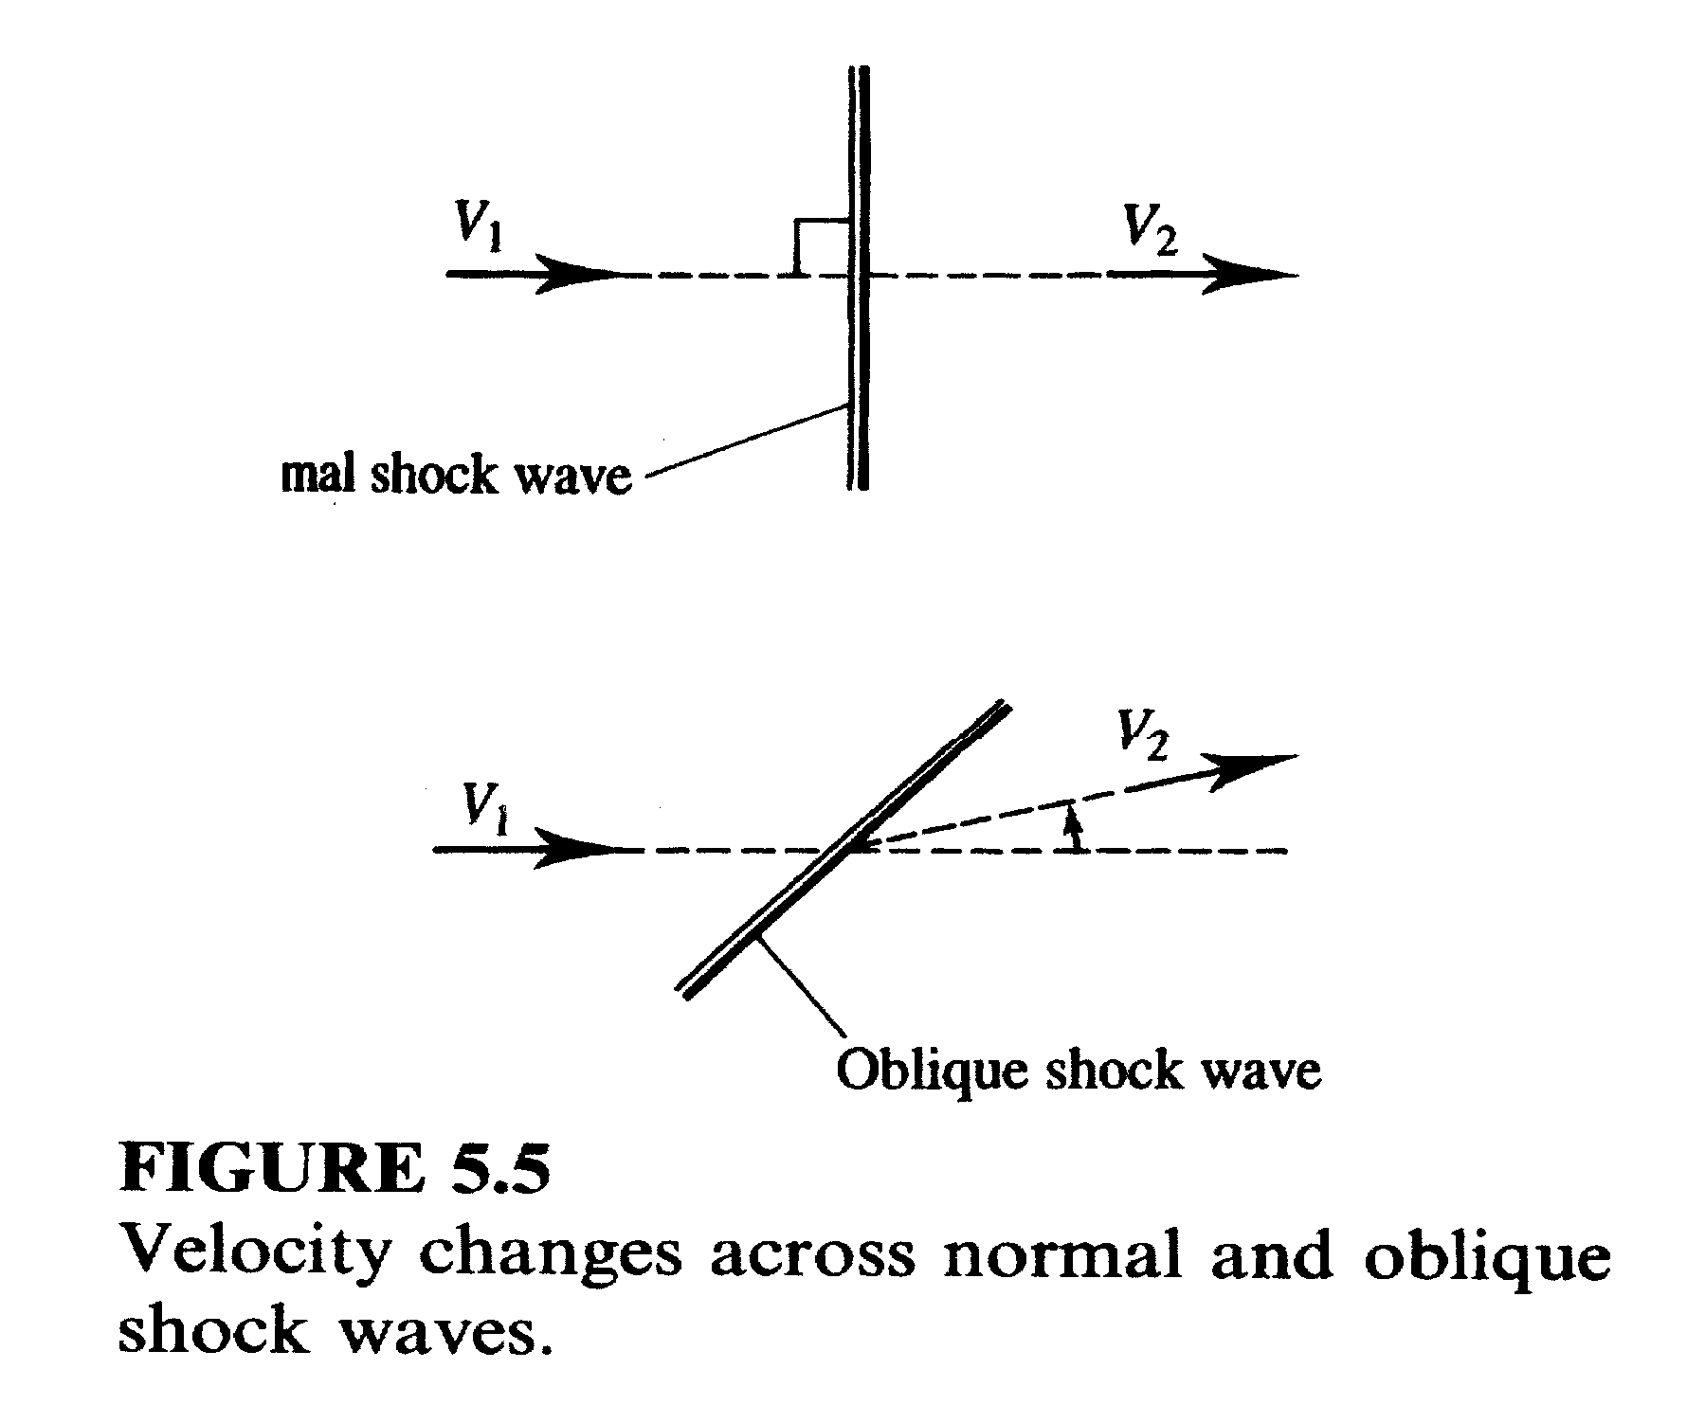

Slide 14
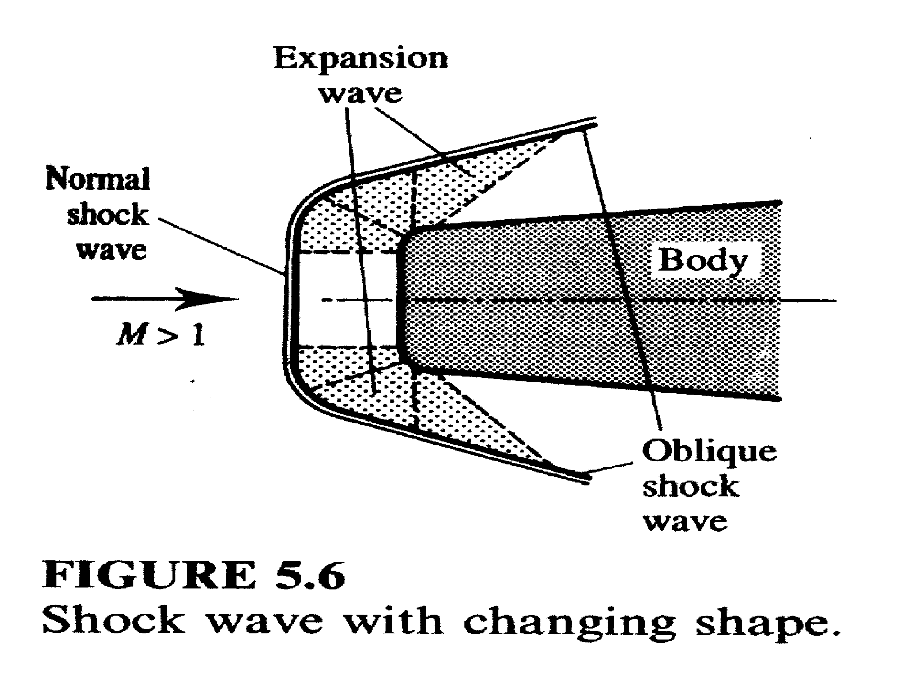

Slide 15
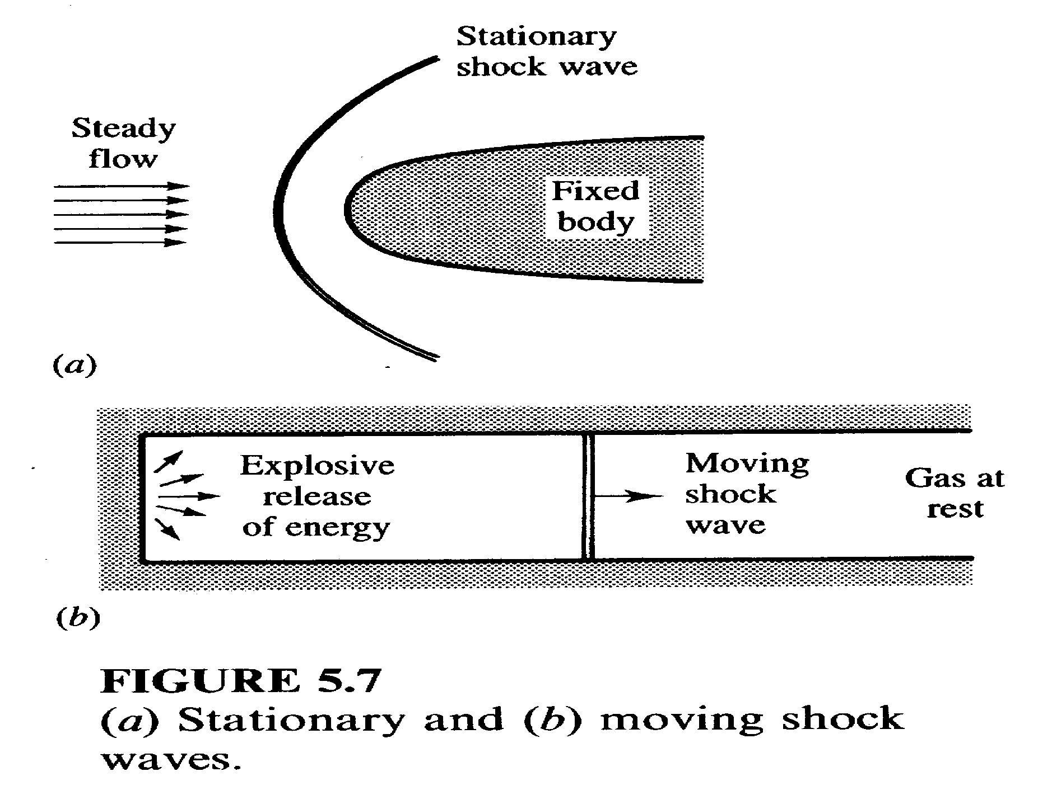

Slide 16
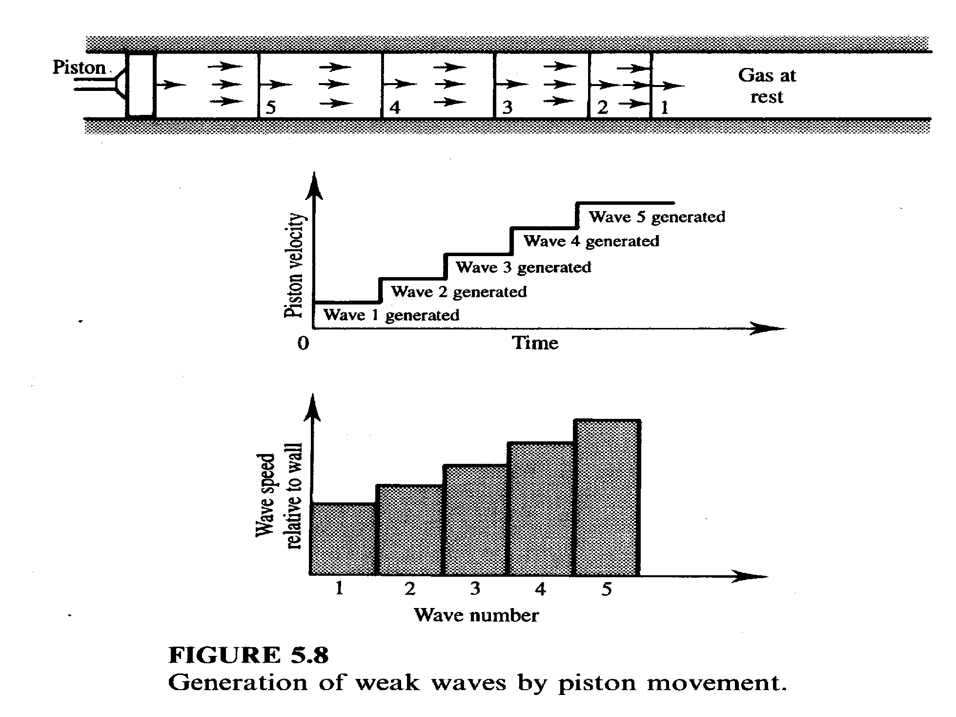

Slide 17
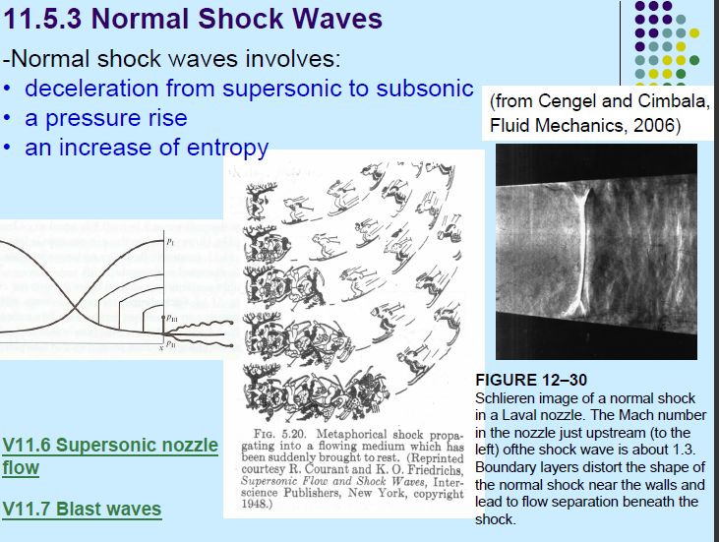

Slide 18
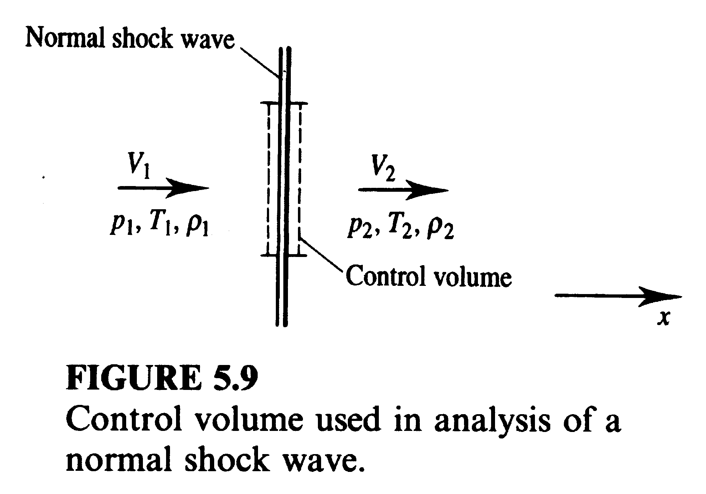

Slide 19
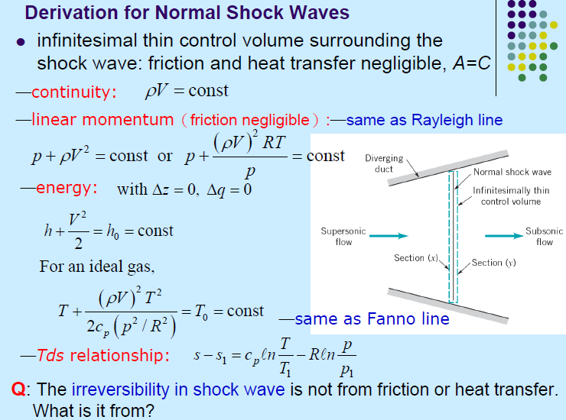

Slide 20
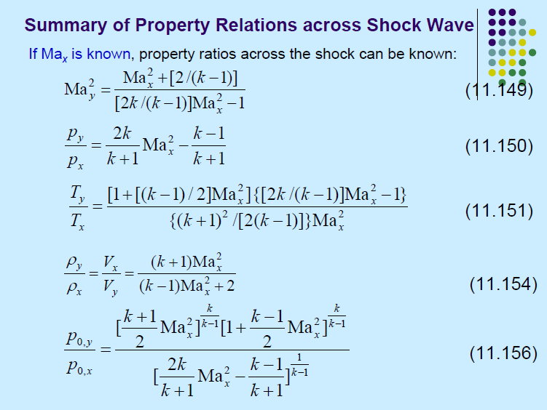

Slide 21

Define strength of a shock wave.
Strength of a shock wave is defined as the ratio of increase in static pressure across the shock to the inlet static pressure.

Slide 22
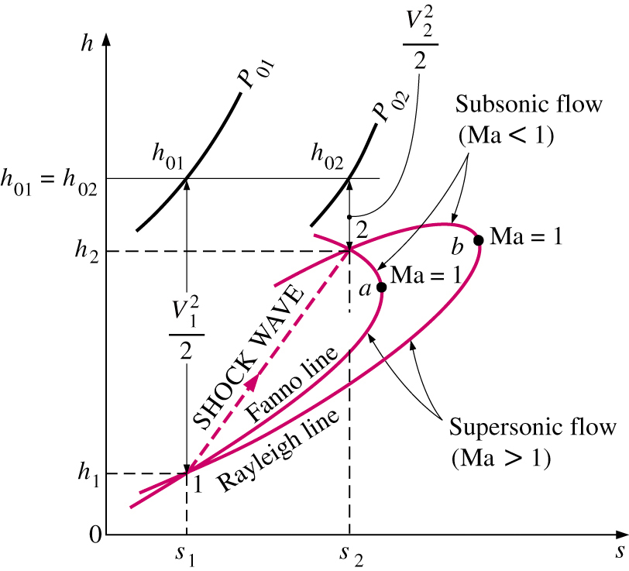
Shock Waves and Expansion Waves
Normal Shocks
Combine conservation of mass and energy into a single equation and plot on h-s diagram
  Fanno Line : locus of states that have the same value of h₀ and mass flux
Combine conservation of mass and momentum into a single equation and plot on h-s diagram
  Rayleigh line
Points of maximum entropy correspond to Ma = 1.
  Above / below this point is subsonic / supersonic

Slide 23
Shock Waves and Expansion Waves
Normal Shocks
There are 2 points where the Fanno and Rayleigh lines intersect : points where all 3 conservation equations are satisfied
  Point 1: before the shock (supersonic)
  Point 2: after the shock (subsonic)
The larger Ma is before the shock, the stronger the shock will be.
Entropy increases from point 1 to point 2 : expected since flow through the shock is adiabatic but irreversible

Slide 24
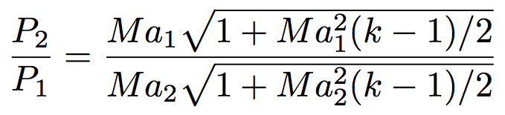
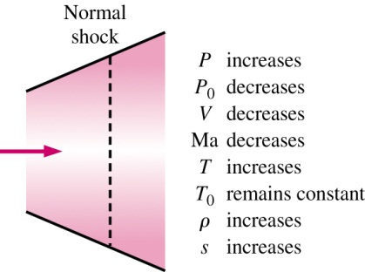
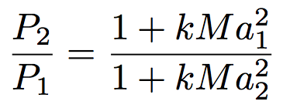
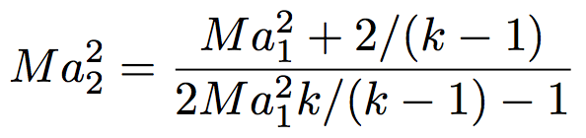
Shock Waves and Expansion Waves
Normal Shocks
Equation for the Fanno line for an ideal gas with constant specific heats can be derived
Similar relation for Rayleigh line is
Combining this gives the intersection points

Slide 25
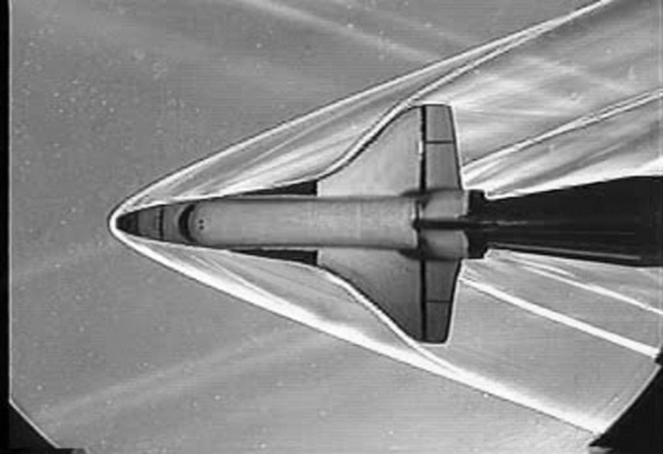
Shock Waves and Expansion Waves
Oblique Shocks
Not all shocks are normal to flow direction.
Some are inclined to the flow direction, and are called oblique shocks

Slide 26
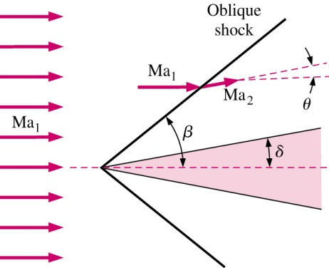
Shock Waves and Expansion Waves
Oblique Shocks
At leading edge, flow is deflected through an angle θ called the turning angle
Result is a straight oblique shock wave aligned at shock angle β relative to the flow direction
Due to the displacement thickness, θ is slightly greater than the wedge half-angle δ.

Slide 27
Shock Waves and Expansion Waves
Oblique Shocks
Like normal shocks, Ma decreases across the oblique shock, and are only possible if upstream flow is supersonic
However, unlike normal shocks in which the downstream Ma is always subsonic, Ma₂ of an oblique shock can be subsonic, sonic, or supersonic depending upon Ma₁ and θ.

Slide 28
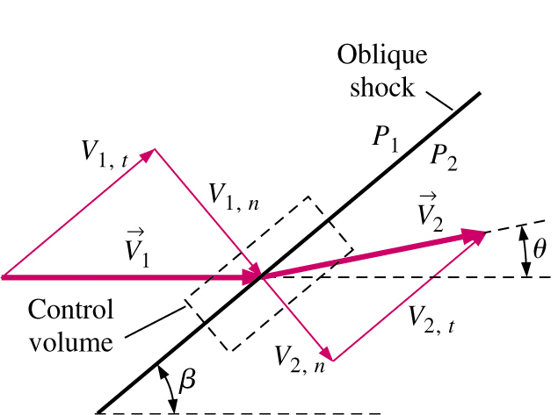
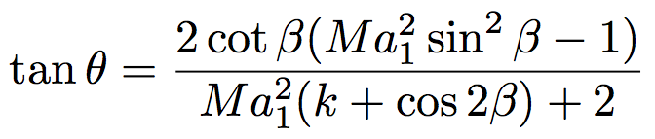
Shock Waves and Expansion Waves
Oblique Shocks
All equations and shock tables for normal shocks apply to oblique shocks as well, provided that we use only the normal components of the Mach number
  Ma_{1,n} = V_{1,n}/c₁
  Ma_{2,n} = V_{2,n}/c₂
θ−β-Ma relationship

Slide 29
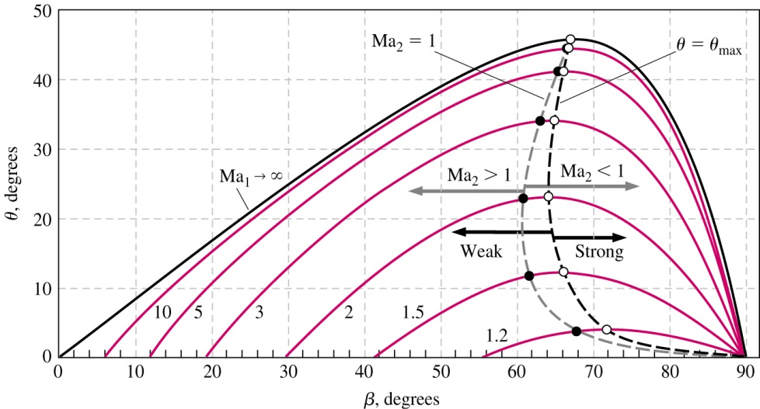
Shock Waves and Expansion Waves
Oblique Shocks

Slide 30
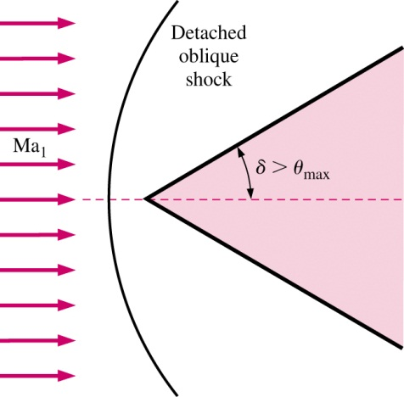
Shock Waves and Expansion Waves
Oblique Shocks
If wedge half angle θ > θ_{max}, a detached oblique shock or bow wave is formed
Much more complicated that straight oblique shocks.
Requires CFD for analysis.

Slide 31
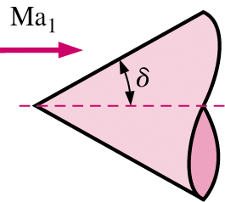
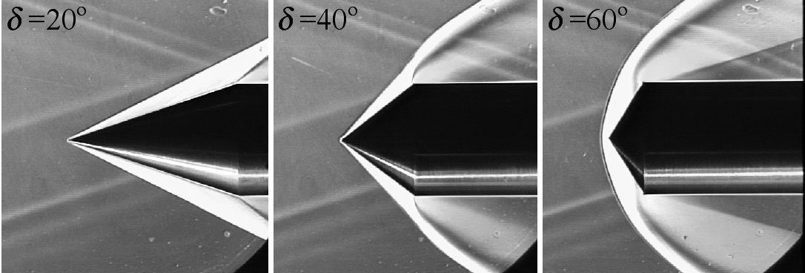
Shock Waves and Expansion Waves
Oblique Shocks
Similar shock waves see for axisymmetric bodies, however, θ−β-Ma relationship and resulting diagram is different than for 2D bodies

Slide 32
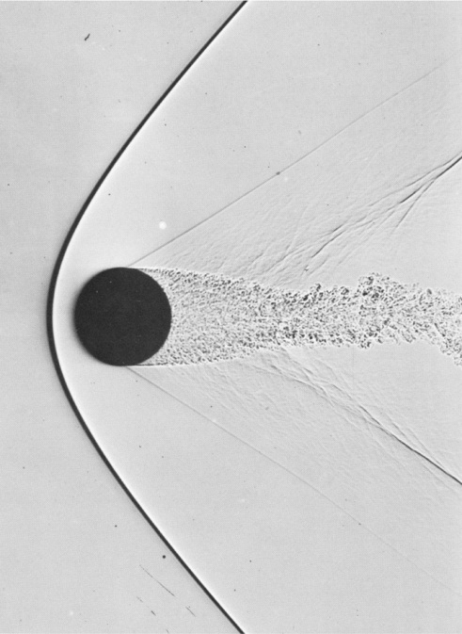
Shock Waves and Expansion Waves
Oblique Shocks
For blunt bodies, without a sharply pointed nose, δ = 90°, and an attached oblique shock cannot exist regardless of Ma.

Slide 33
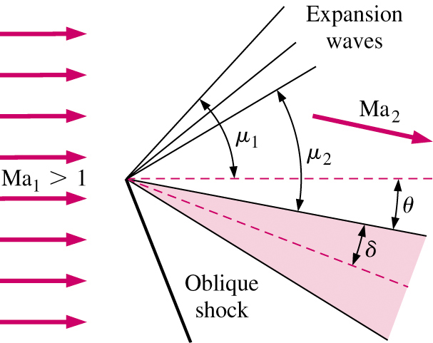
Shock Waves and Expansion Waves
Prandtl-Meyer Expansion Waves
In some cases, flow is turned in the opposite direction across the shock
Example : wedge at angle of attack θ greater than wedge half angle δ
This type of flow is called an expanding flow, in contrast to the oblique shock which creates a compressing flow.
Instead of a shock, a expansion fan appears, which is comprised of infinite number of Mach waves called Prandtl-Meyer expansion waves
Each individual expansion wave is isentropic : flow across entire expansion fan is isentropic
Ma₂ > Ma₁
P, ρ, T decrease across the fan
Flow turns gradually as each
successful Mach wave turns
the flow ay an infinitesimal amount

Slide 34
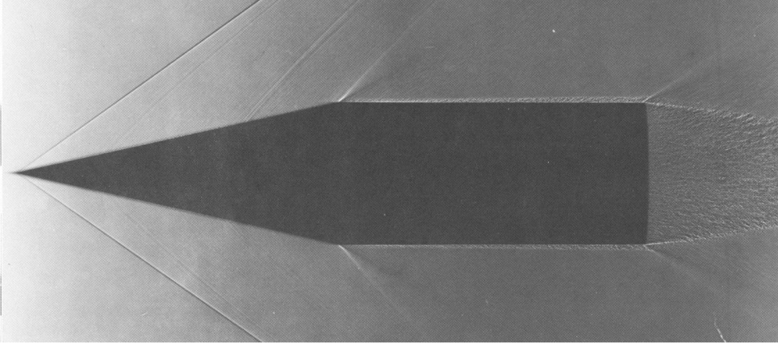
Shock Waves and Expansion Waves
Prandtl-Meyer Expansion Waves
Prandtl-Meyer expansion fans also occur in axisymmetric flows, as in the corners and trailing edges of the cone cylinder.

Slide 35
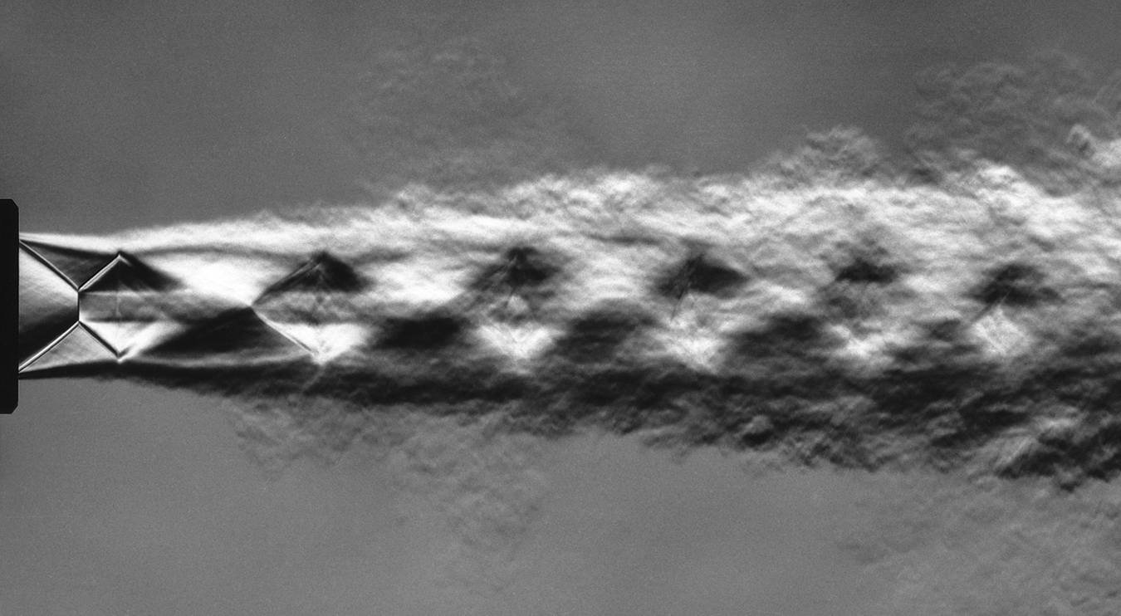
Shock Waves and Expansion Waves
Prandtl-Meyer Expansion Waves
Interaction between shock waves and expansions waves in “over expanded” supersonic jet

